Slide 1

People Counting
using CNN and
OpenCV
Comparative analysis
between
Haar Cascade and Yolov3 CNN Classifiers
Puru Singh
Ishit Singh
Pratyush Pandey

Slide 2

Introduction
This project focuses on detecting people
from images and videos to:
Count total number of people
Draw bounding box on detected people
People detection helps us to determine number of people present in a specified area
and people density calculation which is helpful in surveillance and survey systems.

Slide 3

Languages, Models and
libraries used:
• Python Programming Language
• OpenCV Library
• Haar-Cascade Classifier
• Yolov3 Classification model

Slide 4

Difference between:
Haar Cascade Classifier
YoloV3 Classifier
• Haar cascade detects features using
hardcoded filters.
• YoloV3 detects features using
convolutional neural networks (CNNs).
• Hence super fast performance.
• Comparative slower than hardcoded
filters.
• Since the filters consist of hardcoded
values the classifier is not adaptable and
can only perform linear separation.
• Since the model is trained from data the
kernels of YoloV3 can separate linearly
inseparable values.
• Hence lower accuracy,
• Higher accuracy.

Slide 5
Methodology
• Reading image or frames from videos.
• Preprocess the image for classifier.
• Detect people using loaded classifier.
• Calculate bounding box values for detected people.
• Drawing bounding box on frame.
• Drawing a people count on frame.
• Showing the frame.

Slide 6
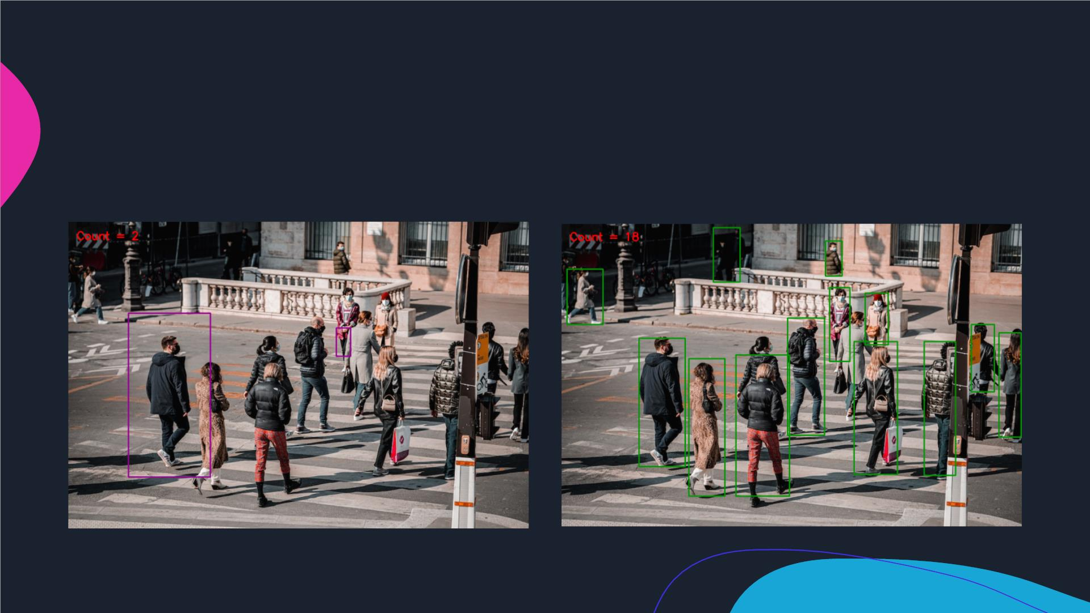
Result of Classifiers on an image:
Haar Cascade Classifier:
YoloV3 Classifier:

Slide 7
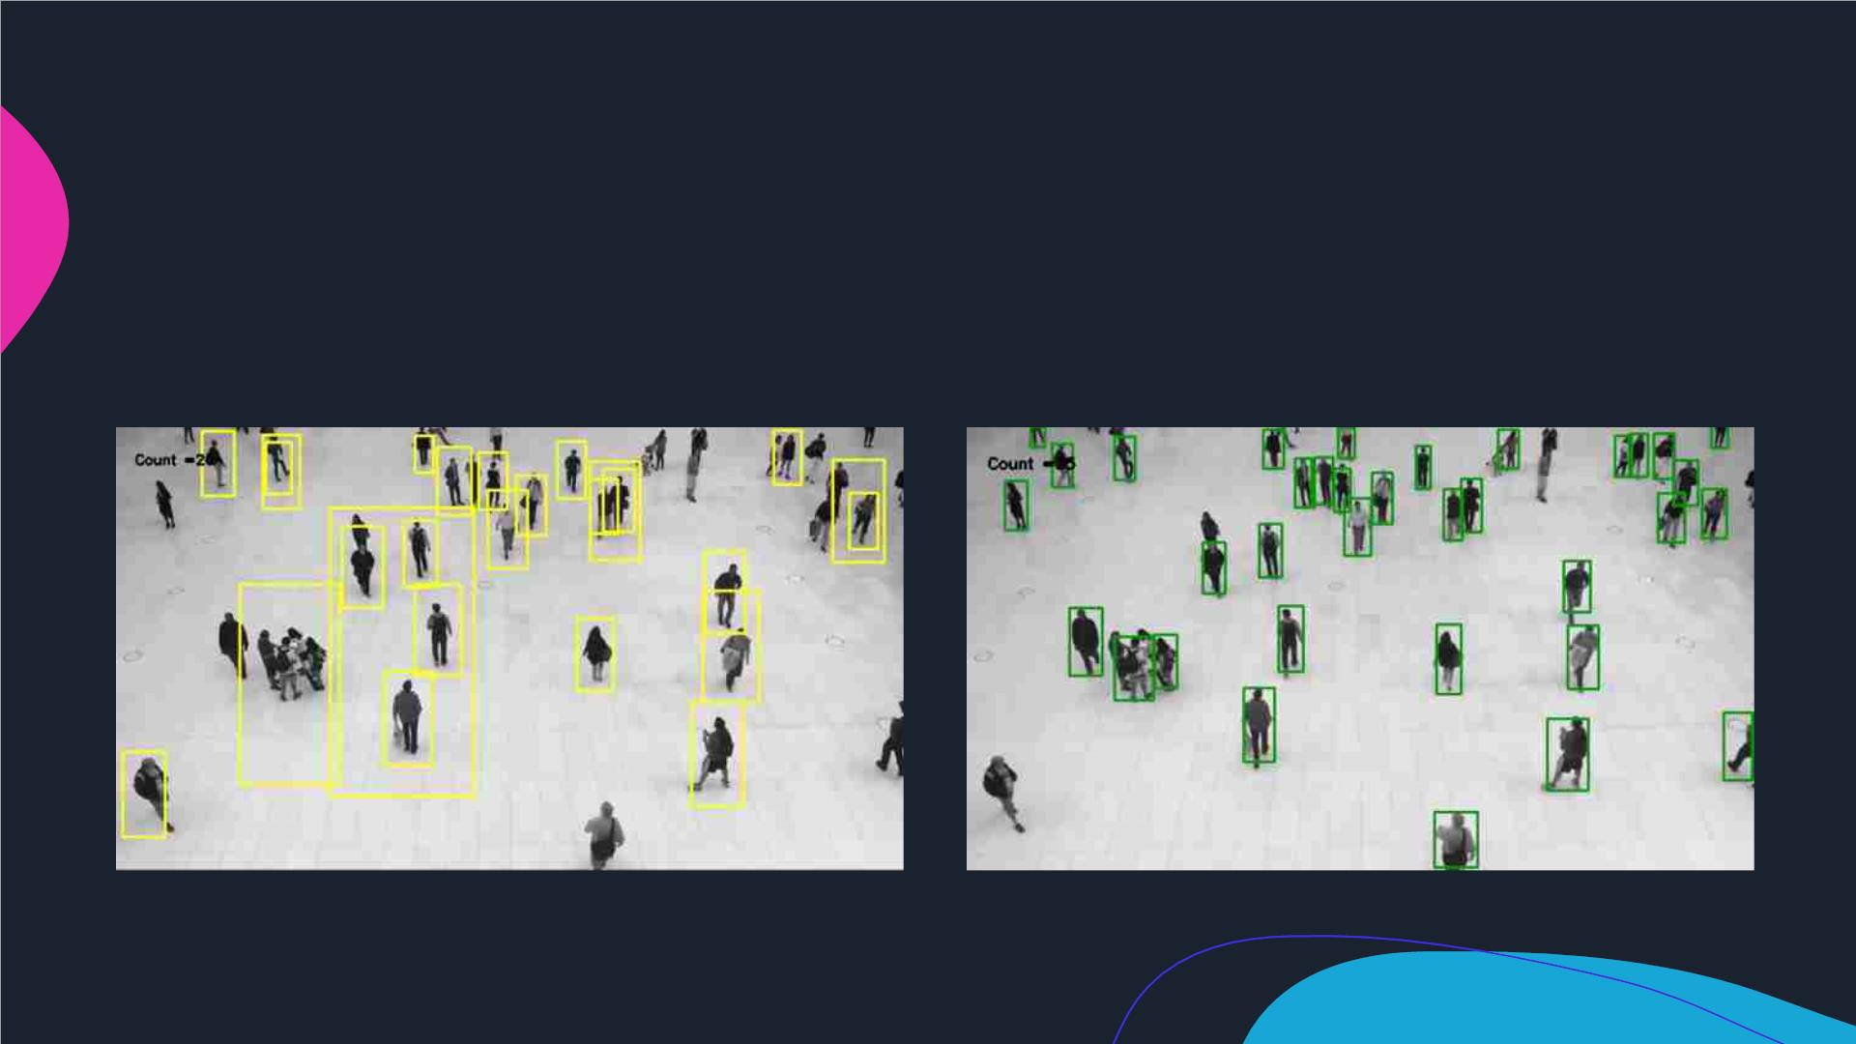
Result of Classifiers on a video:
Haar Cascade Classifier:
YoloV3 Classifier:

Slide 8

Conclusion
YoloV3 proves to be a
This program can be
more accurate method of
applying people detection
in a program.
used in public areas for
surveillance, survey and
crowd control systems.

Slide 9
Thank you!
Presentation by
Puru Singh
Ishit Singh
Pratyush Pandey

